Slide 1

Security Does Not Need To Be Fun: Ignoring OWASP To Have A Terrible Time

Slide 2



Hi, I’m Dwayne
I live in Chicago
I’ve been a Developer Advocate since 2016
On Twitter @mcdwayne
Happy to chat about anything, hit me up
Besides tech, I love improv, karaoke and going to rock and roll shows!
Dwayne McDaniel

Slide 3

About GitGuardian
GitGuardian is the code security platform for the DevOps generation.
—
With automated secrets detection and remediation, our platform enables Dev, Sec, and Ops to advance together towards the
Secure Software Development Lifecycle.

Slide 4
What Does Good Security Look Like?

Slide 5

Notes:
https://unsplash.com/photos/MtBsjmC4RT0

Slide 6
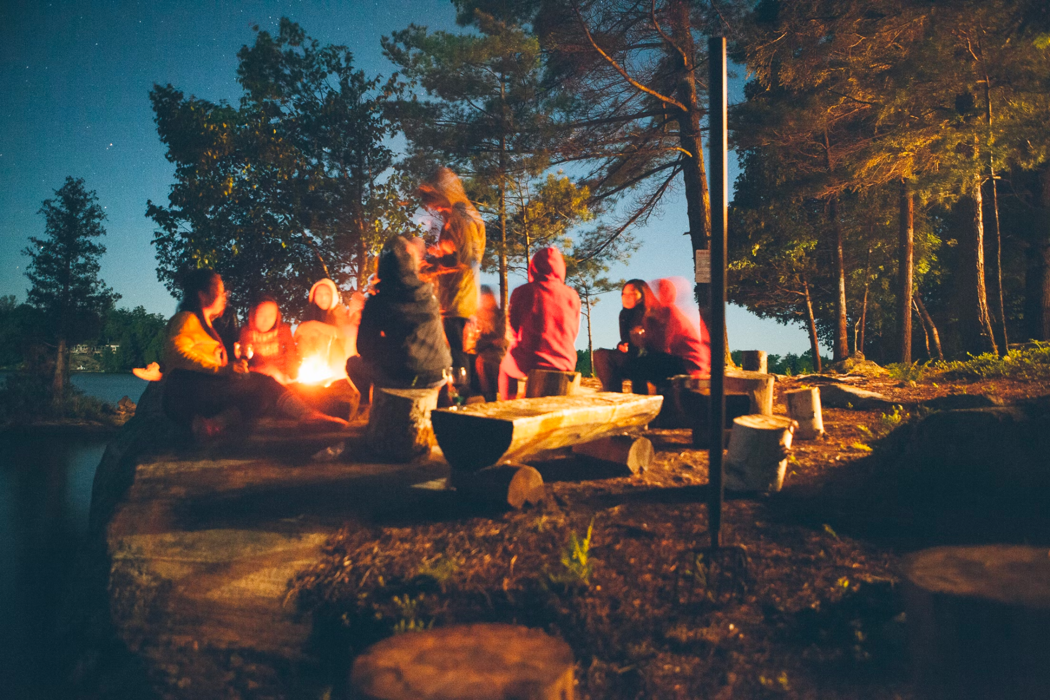
Notes:
https://unsplash.com/photos/fDostElVhN8

Slide 7

Notes:
https://unsplash.com/photos/ZhQCZjr9fHo

Slide 8

Notes:
https://unsplash.com/photos/VJVsEnR_vNE

Slide 9
All Technology Has Human Costs
Notes:
Dev
DevOps
QA
Security

Slide 10
What Does Bad Security Look Like?
Notes:
Dev
DevOps
QA
Security

Slide 11
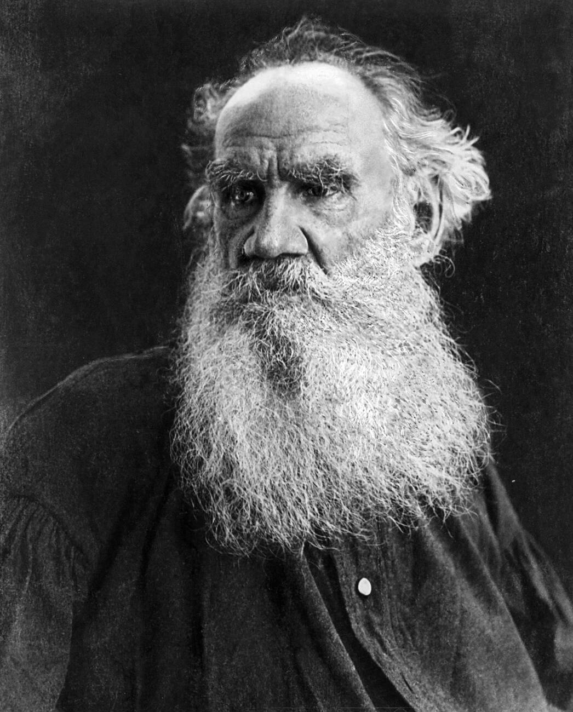
“All happy families are alike; each unhappy family is unhappy in its own way.”
― Leo Tolstoy , Anna Karenina
Notes:
https://en.wikipedia.org/wiki/Leo_Tolstoy#/media/File:Tolstoy_Leo_port.jpg Public domain

Slide 12
A Few Unhappy Families Companies
Apache Log4Shell CVE-2021-44228
Reported: 24 November 2021 - Had existed since 2013
Log4J allowed requests to arbitrary LDAP and JNDI servers, which in turn could execute any code, including opening interactive shells.
Impacted over 44 % of corporate networks worldwide.
Top Companies With Products Affected Include:
Adobe, Cisco, AWS, Broadcom, IBM, Okta, VMware

Slide 13
A Few Unhappy Families Companies
Uber
Reported: 15 Sept, 2022
Teenager from the Lapsus$ hacking group phished login info from a super admin
Immediately discovered access credentials hardcoded in PowerShell scripts that allowed pwnage
Reported first in the New York Times

Slide 14
A Few Unhappy Families Companies
CircleCI
Reported: 4 January 2023
An unauthorized third party leveraged malware deployed to a CircleCI engineer’s laptop in order to steal a valid, 2FA-backed SSO session.
Attackers ultimately gained access to many customers' GitHub OAuth credentials and platform security tokens.
Caused a system wide token rotation, disrupting thousands of customers. Investigation ongoing.

Slide 15
Security Teams Are Outnumbered
Notes:
100 to 1

Slide 16
In the best organizations developers outnumber security team members 100:1 - Alex Rice, HackerOne #Security@2022 🕺🕺🕺🕺🕺🕺🕺🕺🕺🕺🕺🕺🕺🕺🕺🕺🕺🕺🕺🕺
🕺🕺🕺🕺🕺🕺🕺🕺🕺🕺🕺🕺🕺🕺🕺🕺🕺🕺🕺🕺
🕺🕺🕺🕺🕺🕺🕺🕺🕺🕺🕺🕺🕺🕺🕺🕺🕺🕺🕺🕺🚨
🕺🕺🕺🕺🕺🕺🕺🕺🕺🕺🕺🕺🕺🕺🕺🕺🕺🕺🕺🕺
🕺🕺🕺🕺🕺🕺🕺🕺🕺🕺🕺🕺🕺🕺🕺🕺🕺🕺🕺🕺

Slide 17
Shift Left!
Put Everyone On The Security Team
Notes:
100 to 1

Slide 18



But Devs Already Have A Lot To Worry About:
Delivery deadlines
Billable hours
Number of tickets closed
Bugs
DevOps
Fighting Kubernetes
Only so much time
Notes:
Art from https://www.pdclipart.org/thumbnails.php Public domain

Slide 19
Business Priority View of Security
Security Incident
Security Incident
Focus On New Feature Delivery Times
Focus On Security
Delivery Slows Down
Notes:
Art from https://www.pdclipart.org/thumbnails.php Public domain

Slide 20
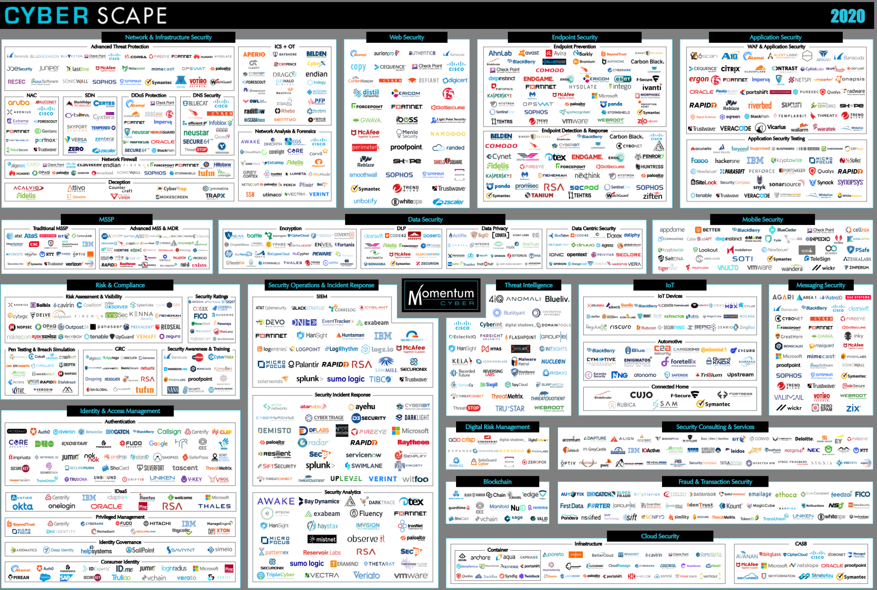
The Number Of Security Tools Is Overwhelming
Notes:
https://www.guidepointsecurity.com/wp-content/uploads/2019/08/CYBERscape.pdf https://www.guidepointsecurity.com/blog/6-best-practices-evaluating-cybersecurity-tools/

Slide 21
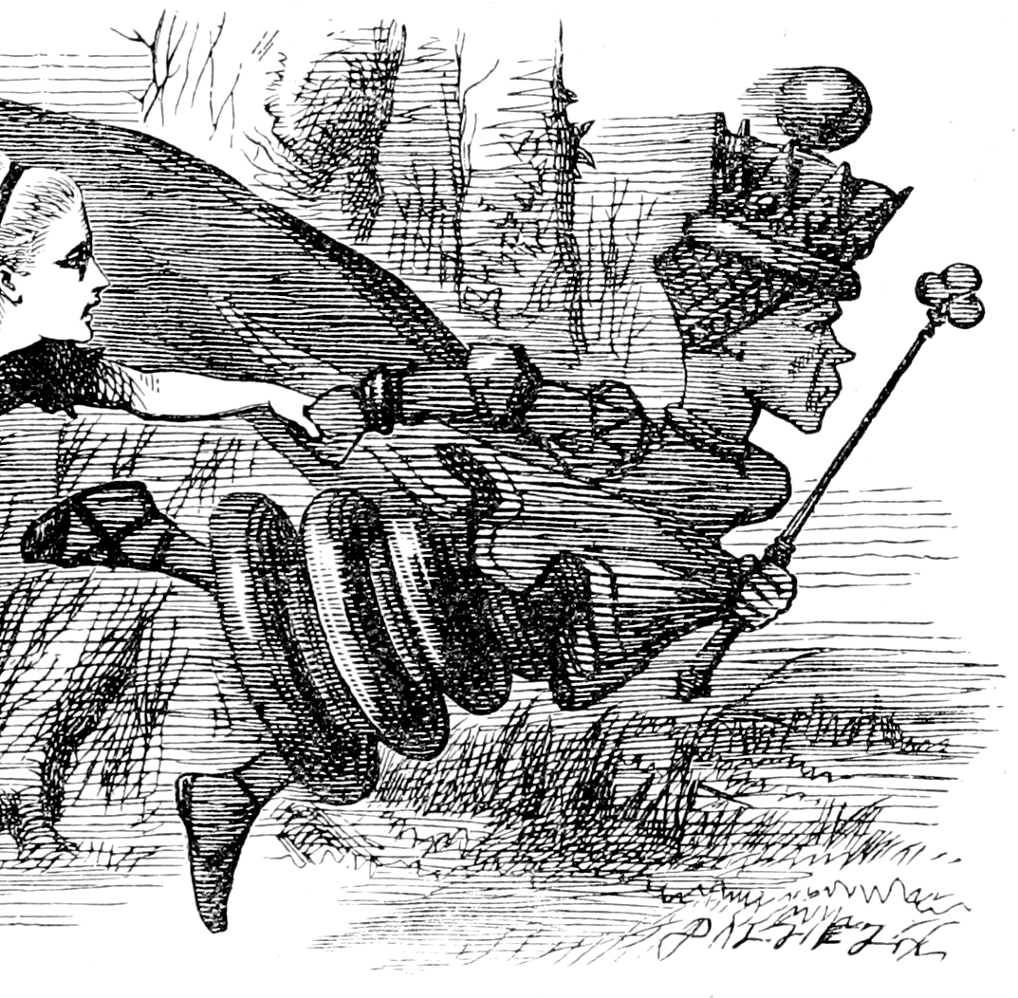
Now, here, you see, it takes all the running you can do, to keep in the same place. If you want to get somewhere else, you must run at least twice as fast as that!
― The Red Queen, Through the Looking-Glass, and What Alice Found There
Notes:
https://en.wikipedia.org/wiki/Red_Queen%27s_race Public domain

Slide 22

I Wish Some Benevolent
Group Of Security Experts Could Help Me With This Stuff

Slide 23

Open Web Application Security Project

Slide 24
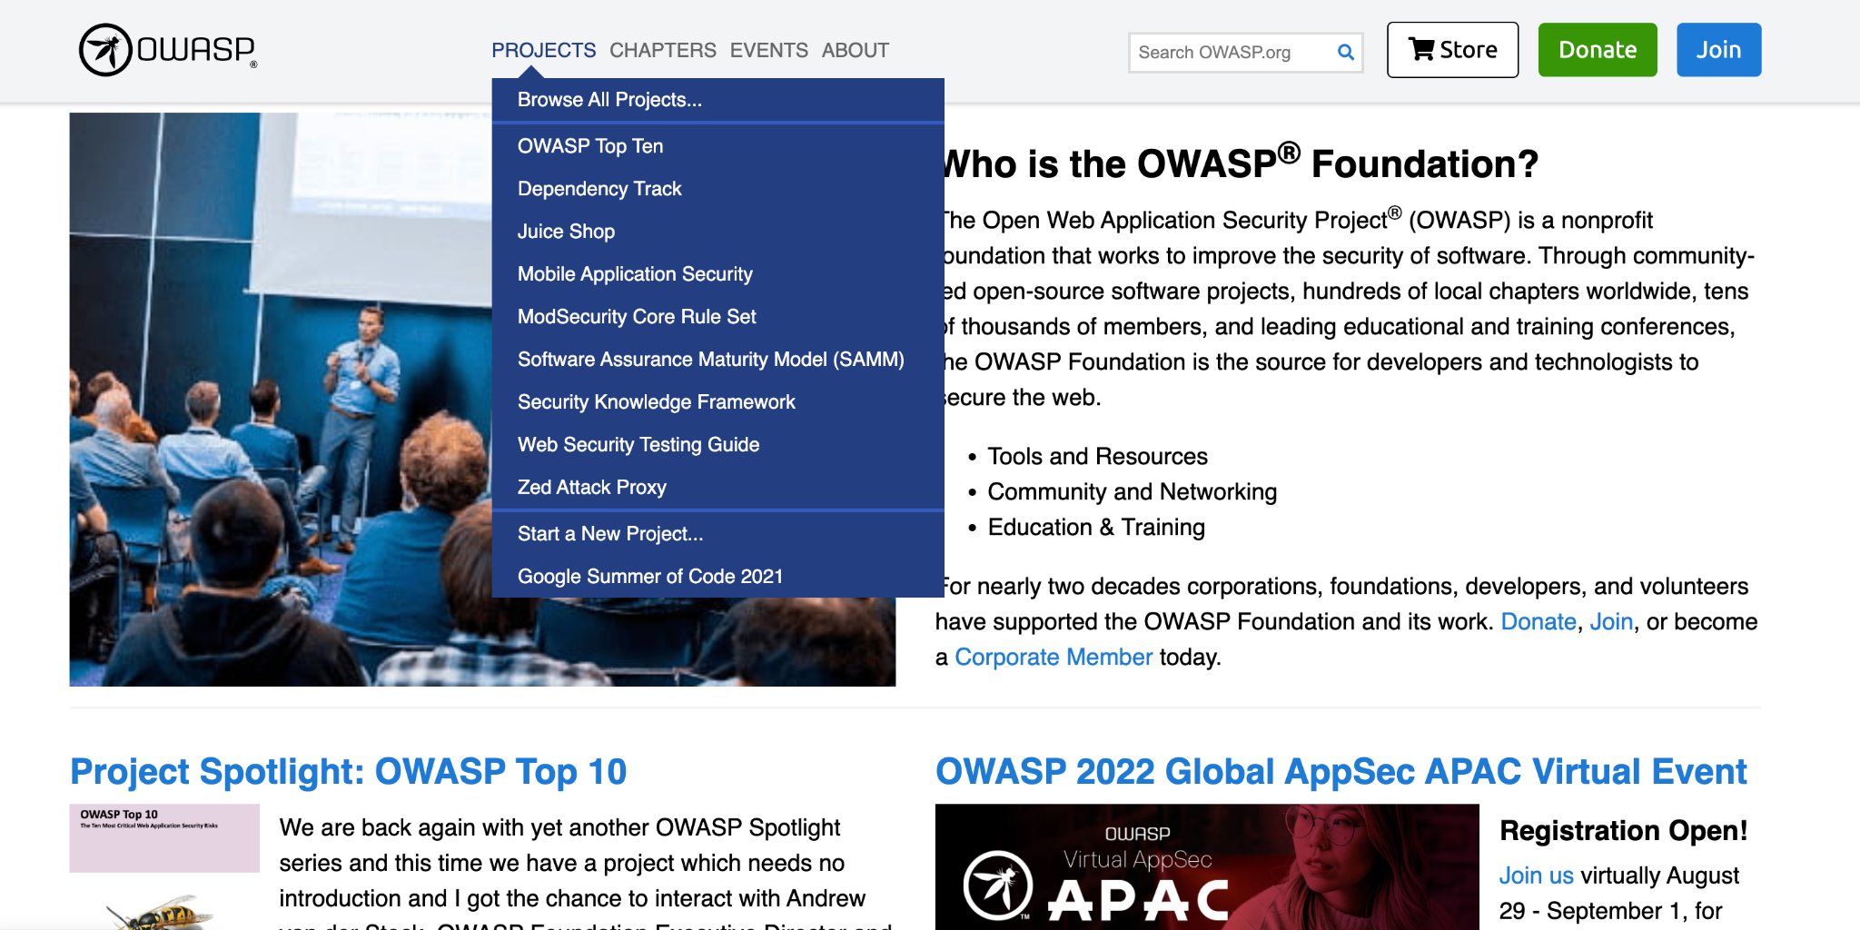
OWASP.ORG

Slide 25

OWASP Mission

Slide 26
OWASP Mission
As the world’s largest non-profit organization concerned with software security, OWASP:
Supports the building of impactful projects;
Develops & nurtures communities through events and chapter meetings worldwide; and
Provides educational publications & resources
in order to enable developers to write better software, and security professionals to make the world’s software more secure.

Slide 27
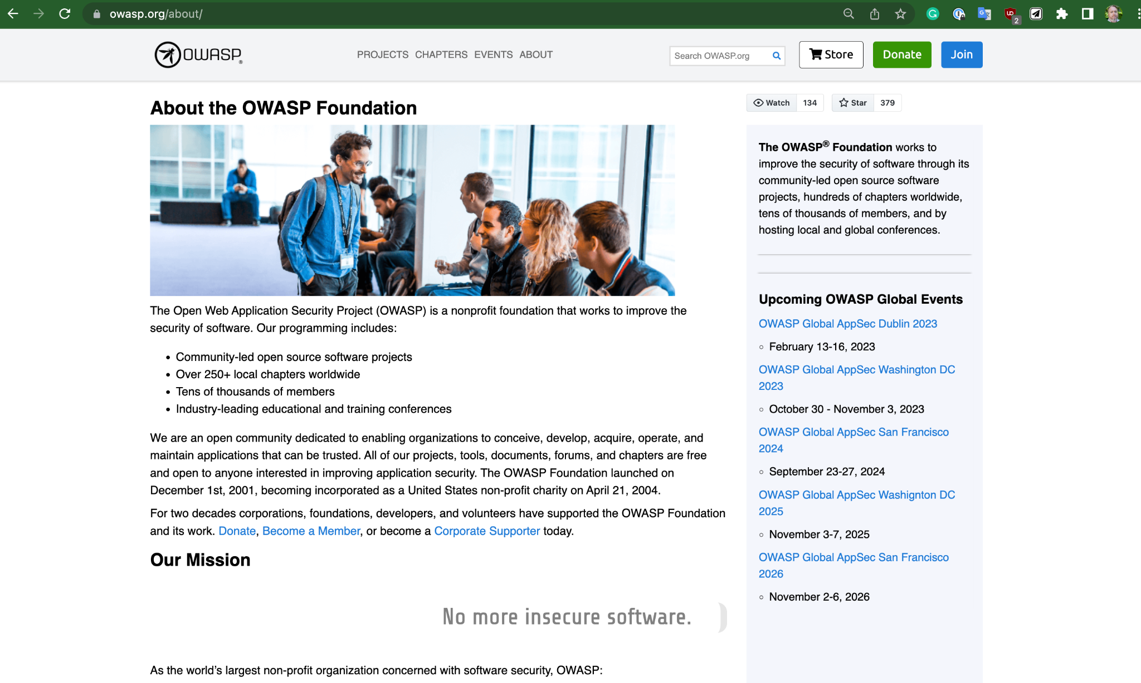
OK, But how do I navigate this site?

Slide 28
Projects
Communities
Events
Education and Training
Publications and Resources
OWASP Overview

Slide 29
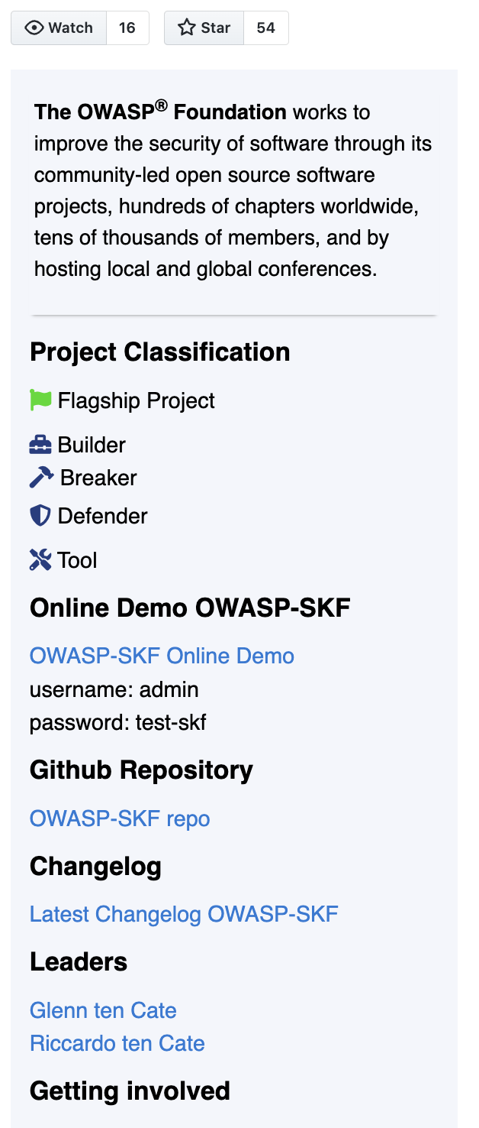
OWASP Projects
Open Source repos
Built by volunteers and experts
New weekly submissions from the community
250 total projects in any state
150 in usable state

Slide 30
Flagship Projects
Production Projects (new)
Lab Projects
Incubator Projects
OWASP Projects Categories

Slide 31
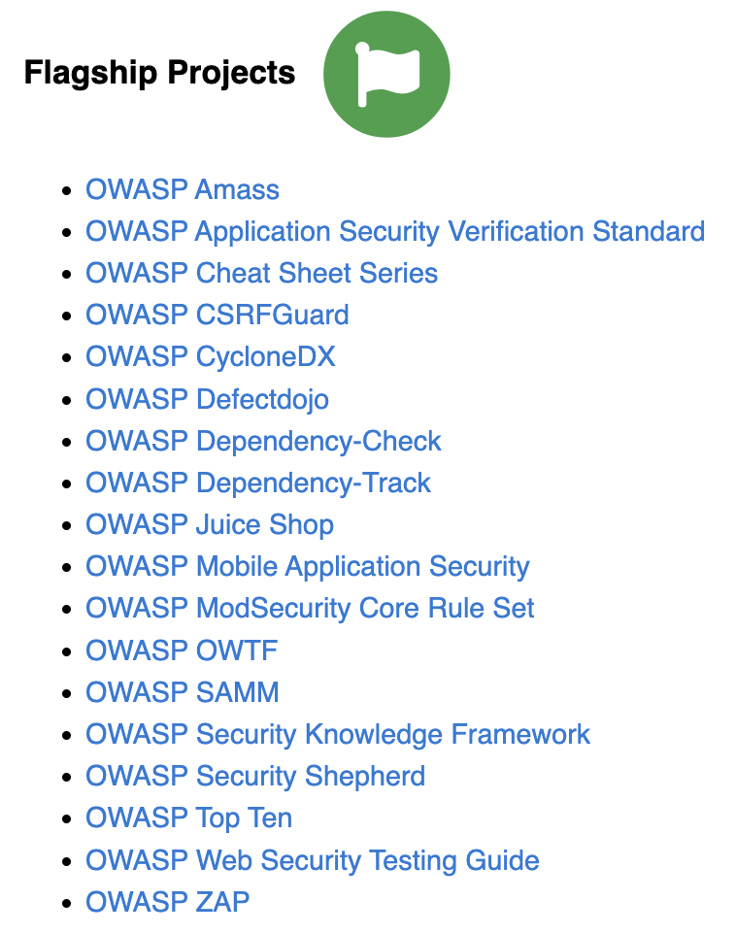
OWASP Flagship Projects
18 Current Flagship Projects:
The OWASP Flagship designation is given to projects that have demonstrated strategic value to OWASP and application security as a whole.

Slide 32
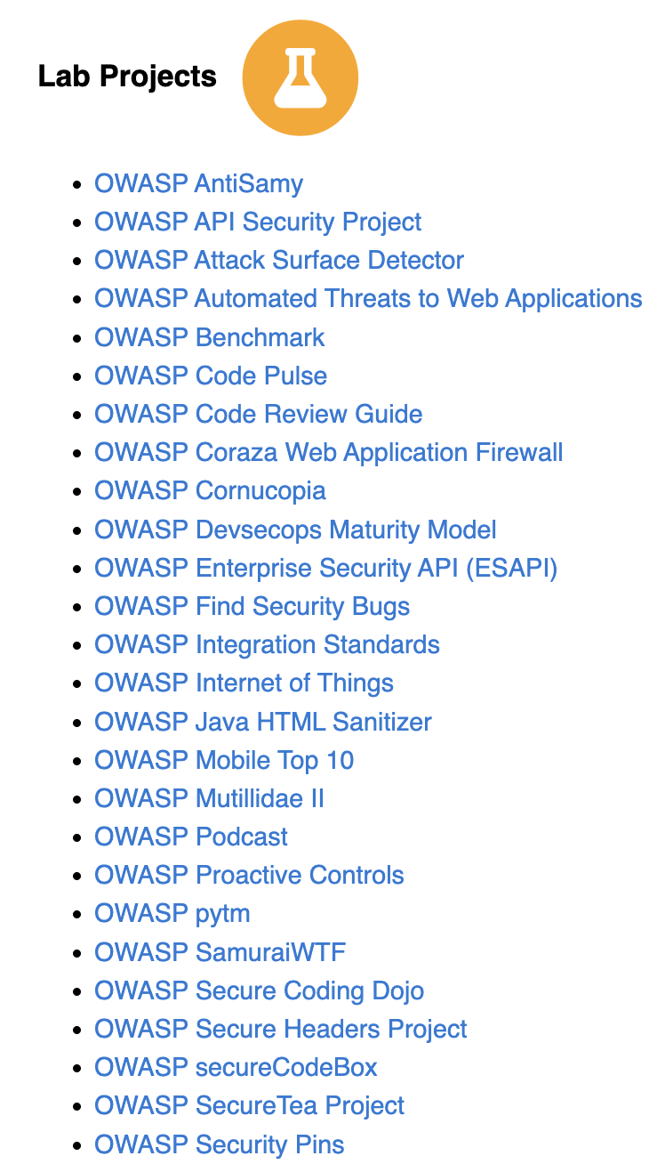
OWASP Lab Projects
34 Lab Projects: OWASP Labs projects represent projects that have produced an OWASP reviewed deliverable of value.

Slide 33
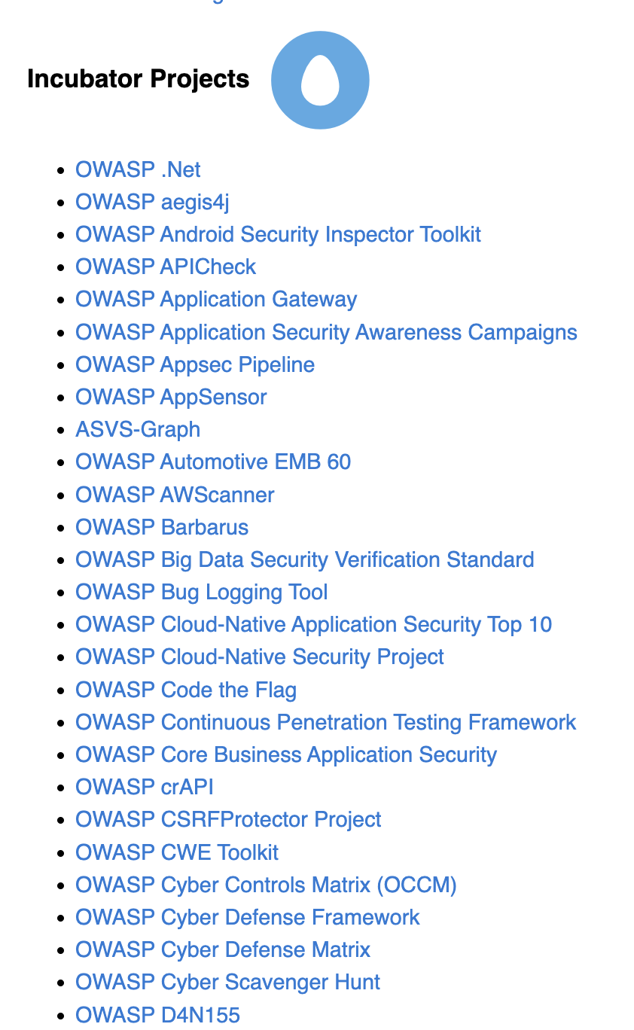
OWASP Incubator Projects
105 Incubator Projects: OWASP Incubator projects represent the experimental playground where projects are still being fleshed out, ideas are still being proven, and development is still underway.

Slide 34
Tool Projects - 75
Documentation Projects - 80
Code Projects - 34
Other - 3
OWASP Projects Types

Slide 35
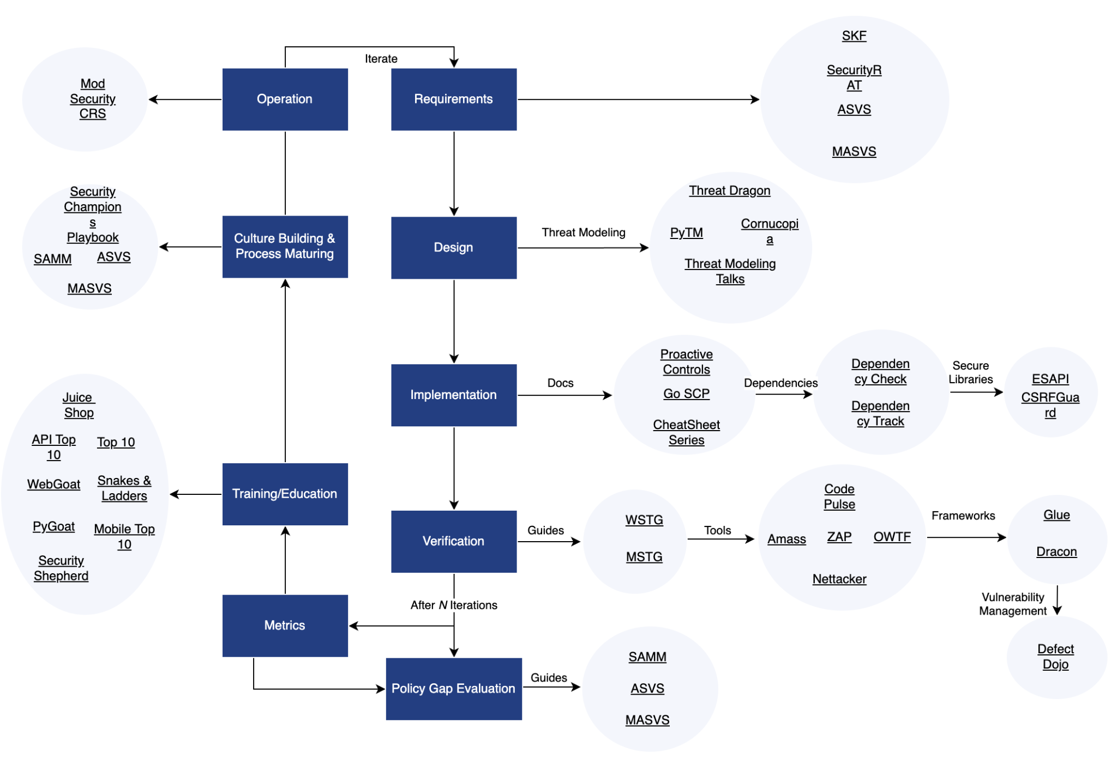
OWASP Projects
Organized around CRE, Common Requirement Enumeration

Slide 36
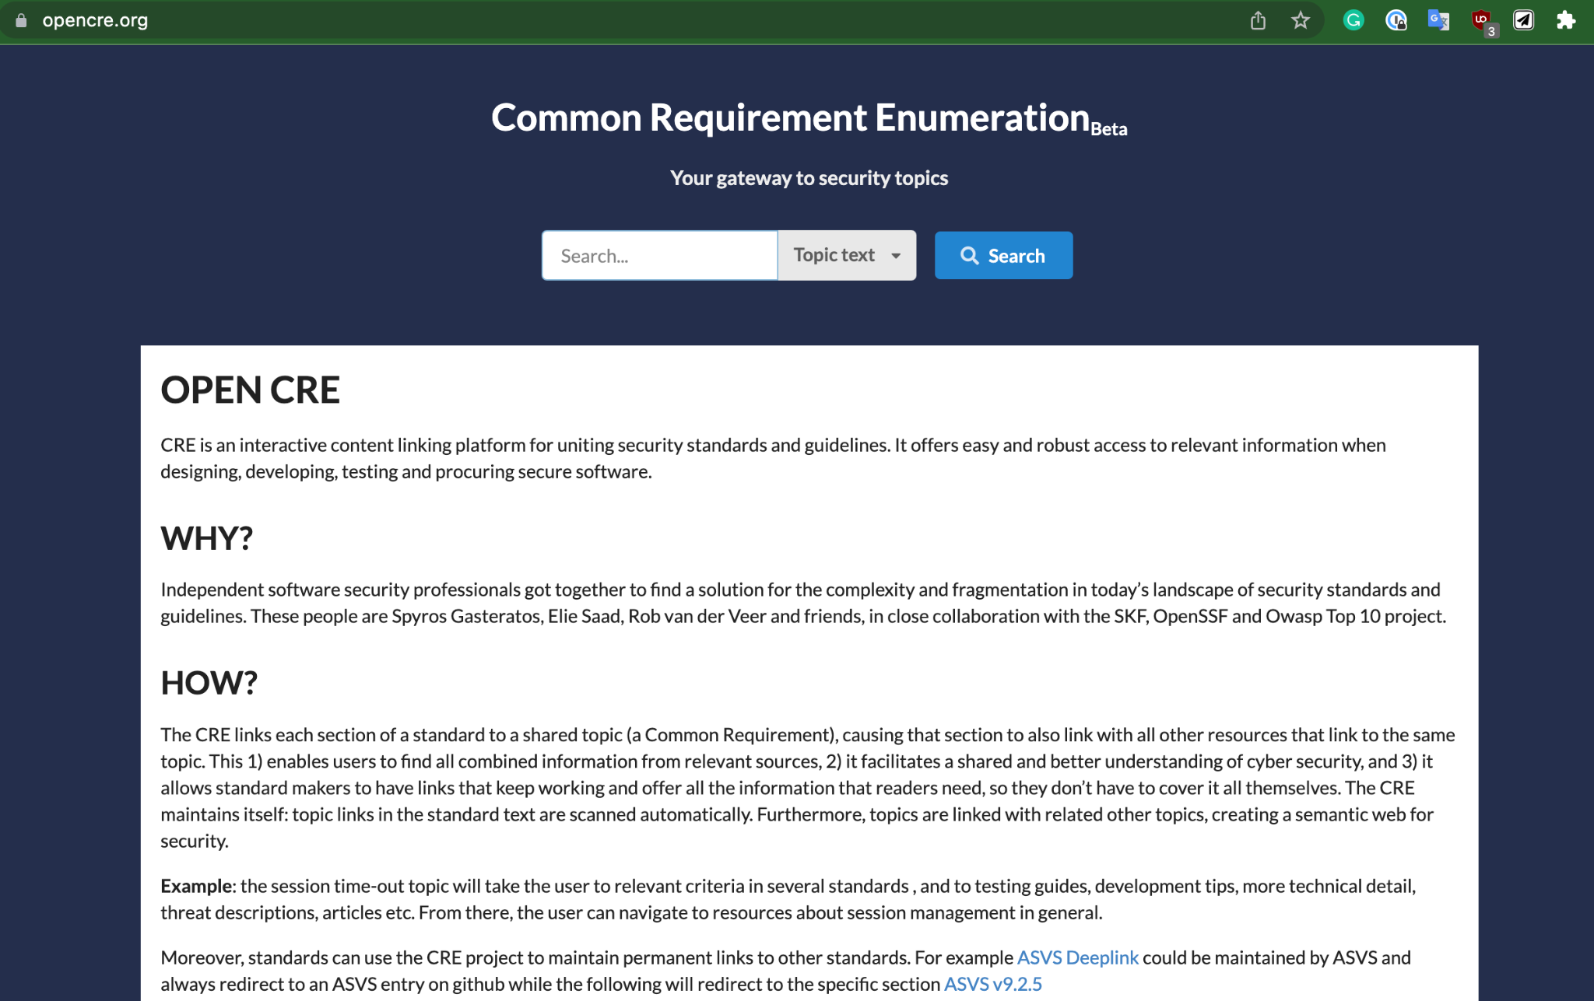
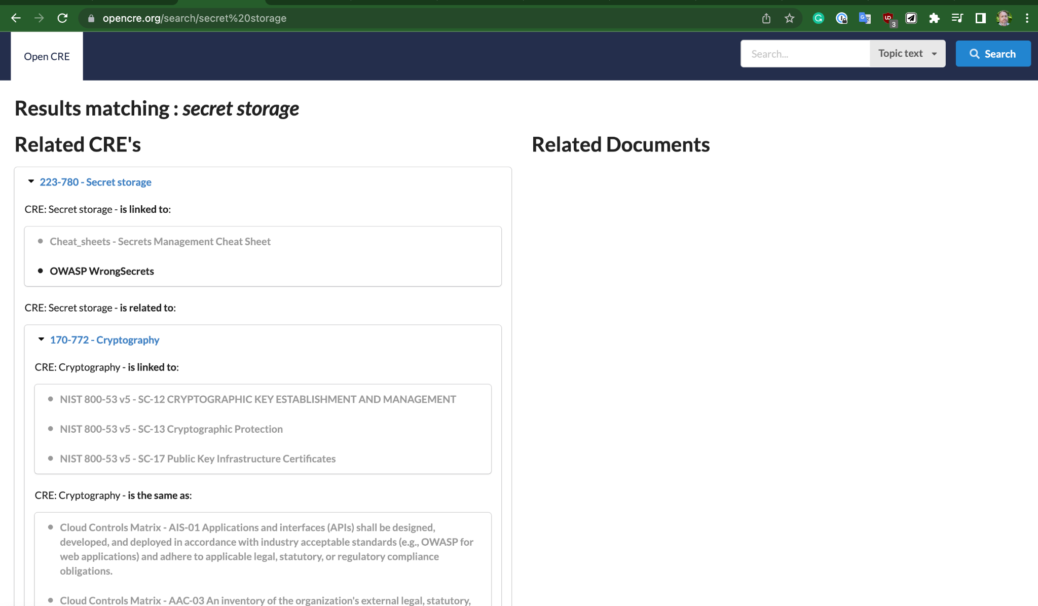
OWASP CRE
Links together standards (NIST, CWE) in a coherent way
Helps clarify what each OWASP project is specifically addressing
https://www.opencre.org allows you to just search the high level topic
Notes:
https://www.youtube.com/watch?v=7knF14t0Svg

Slide 37
Community

Slide 38
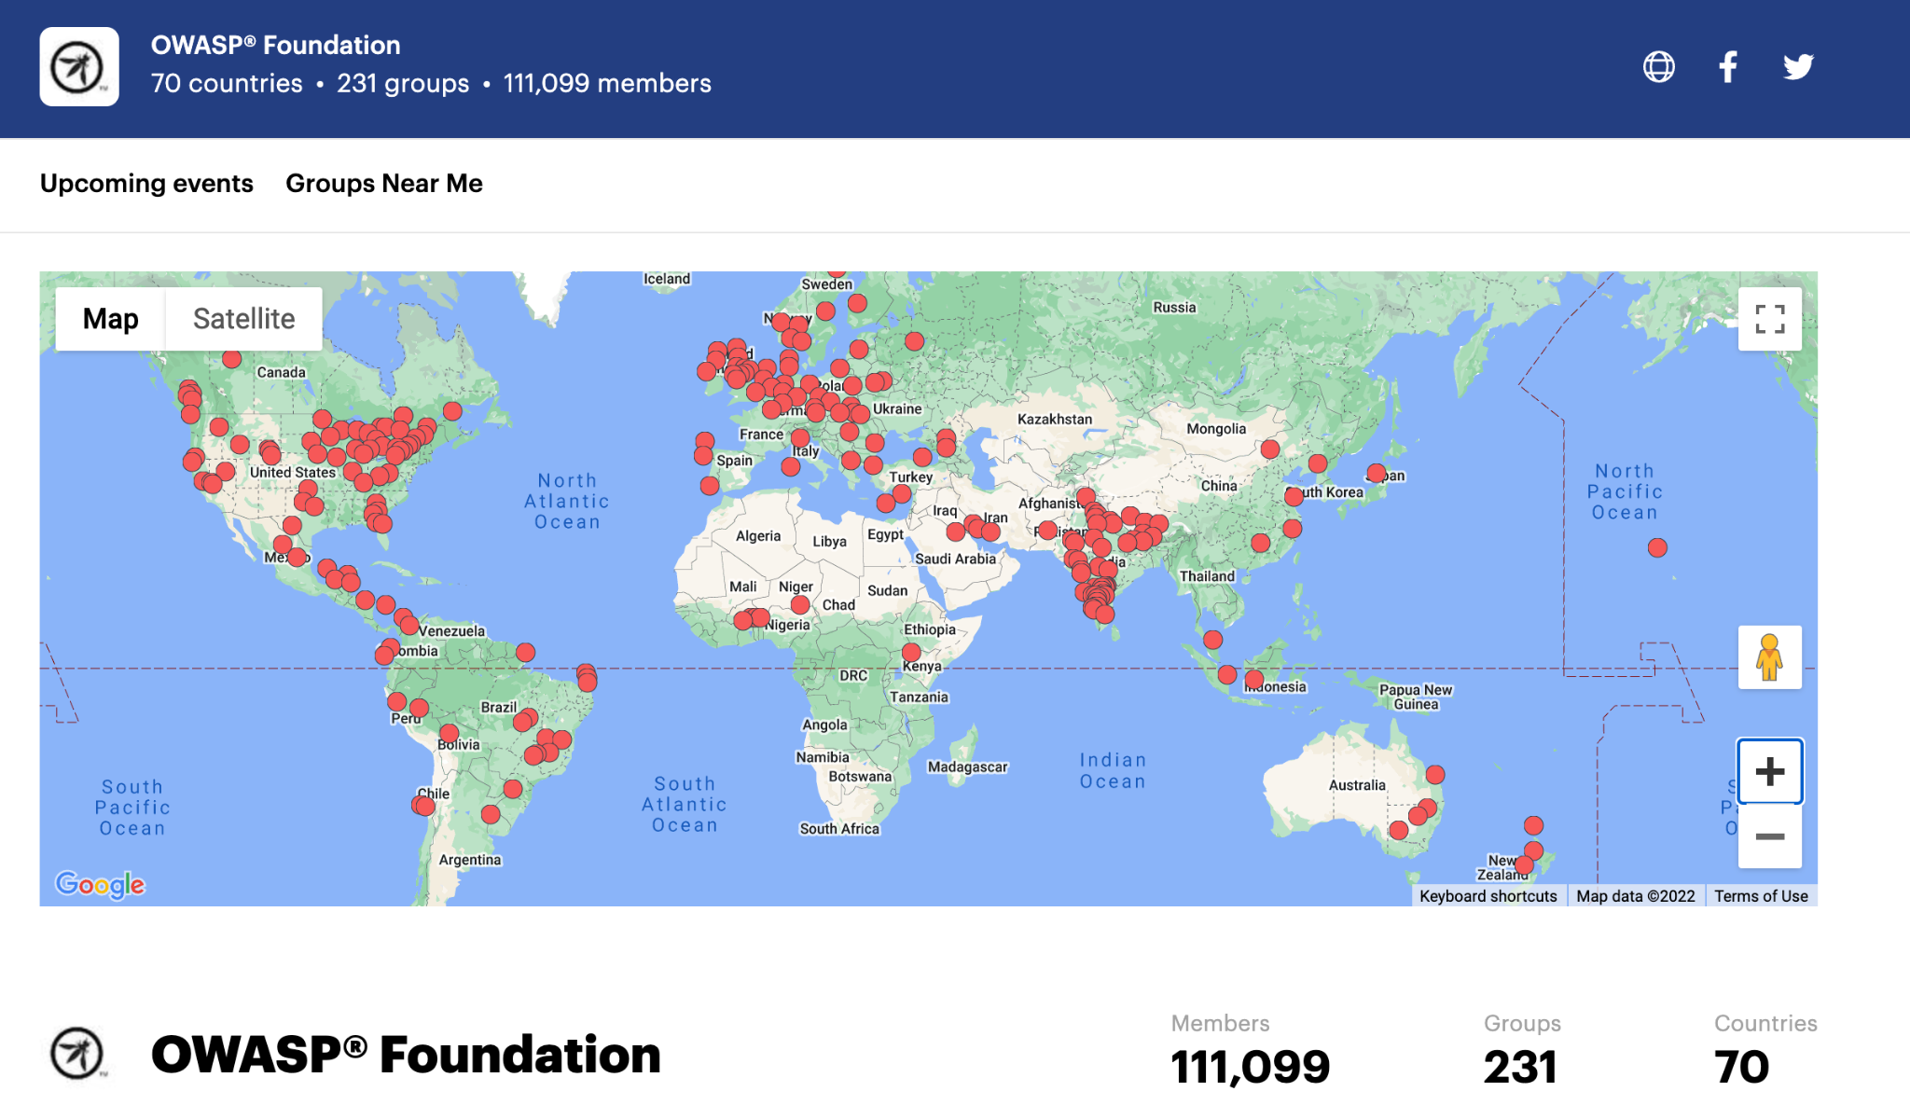
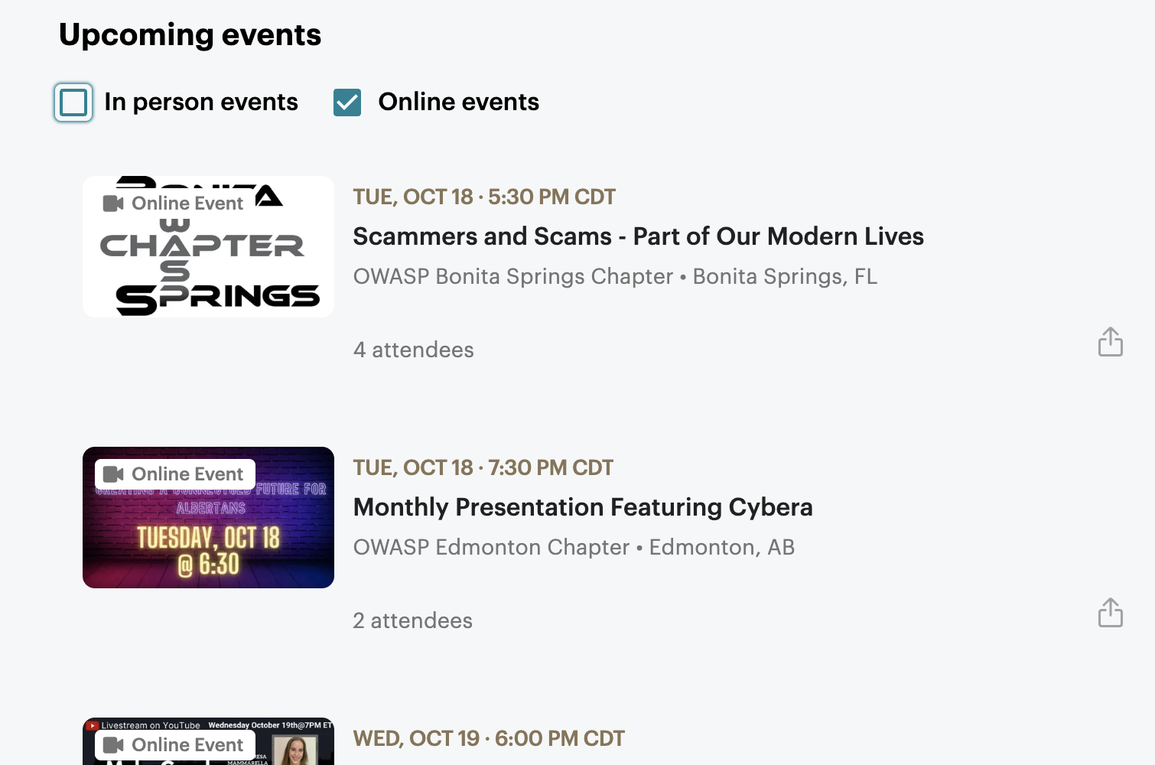
OWASP Community
Chapters all over the world
Organized via MeetUp in most areas Many online events

Slide 39
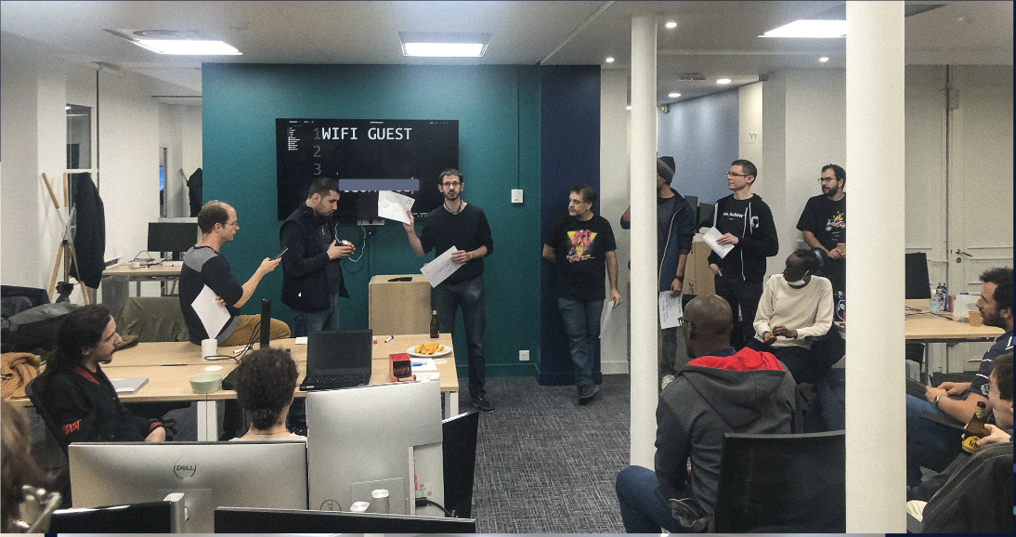
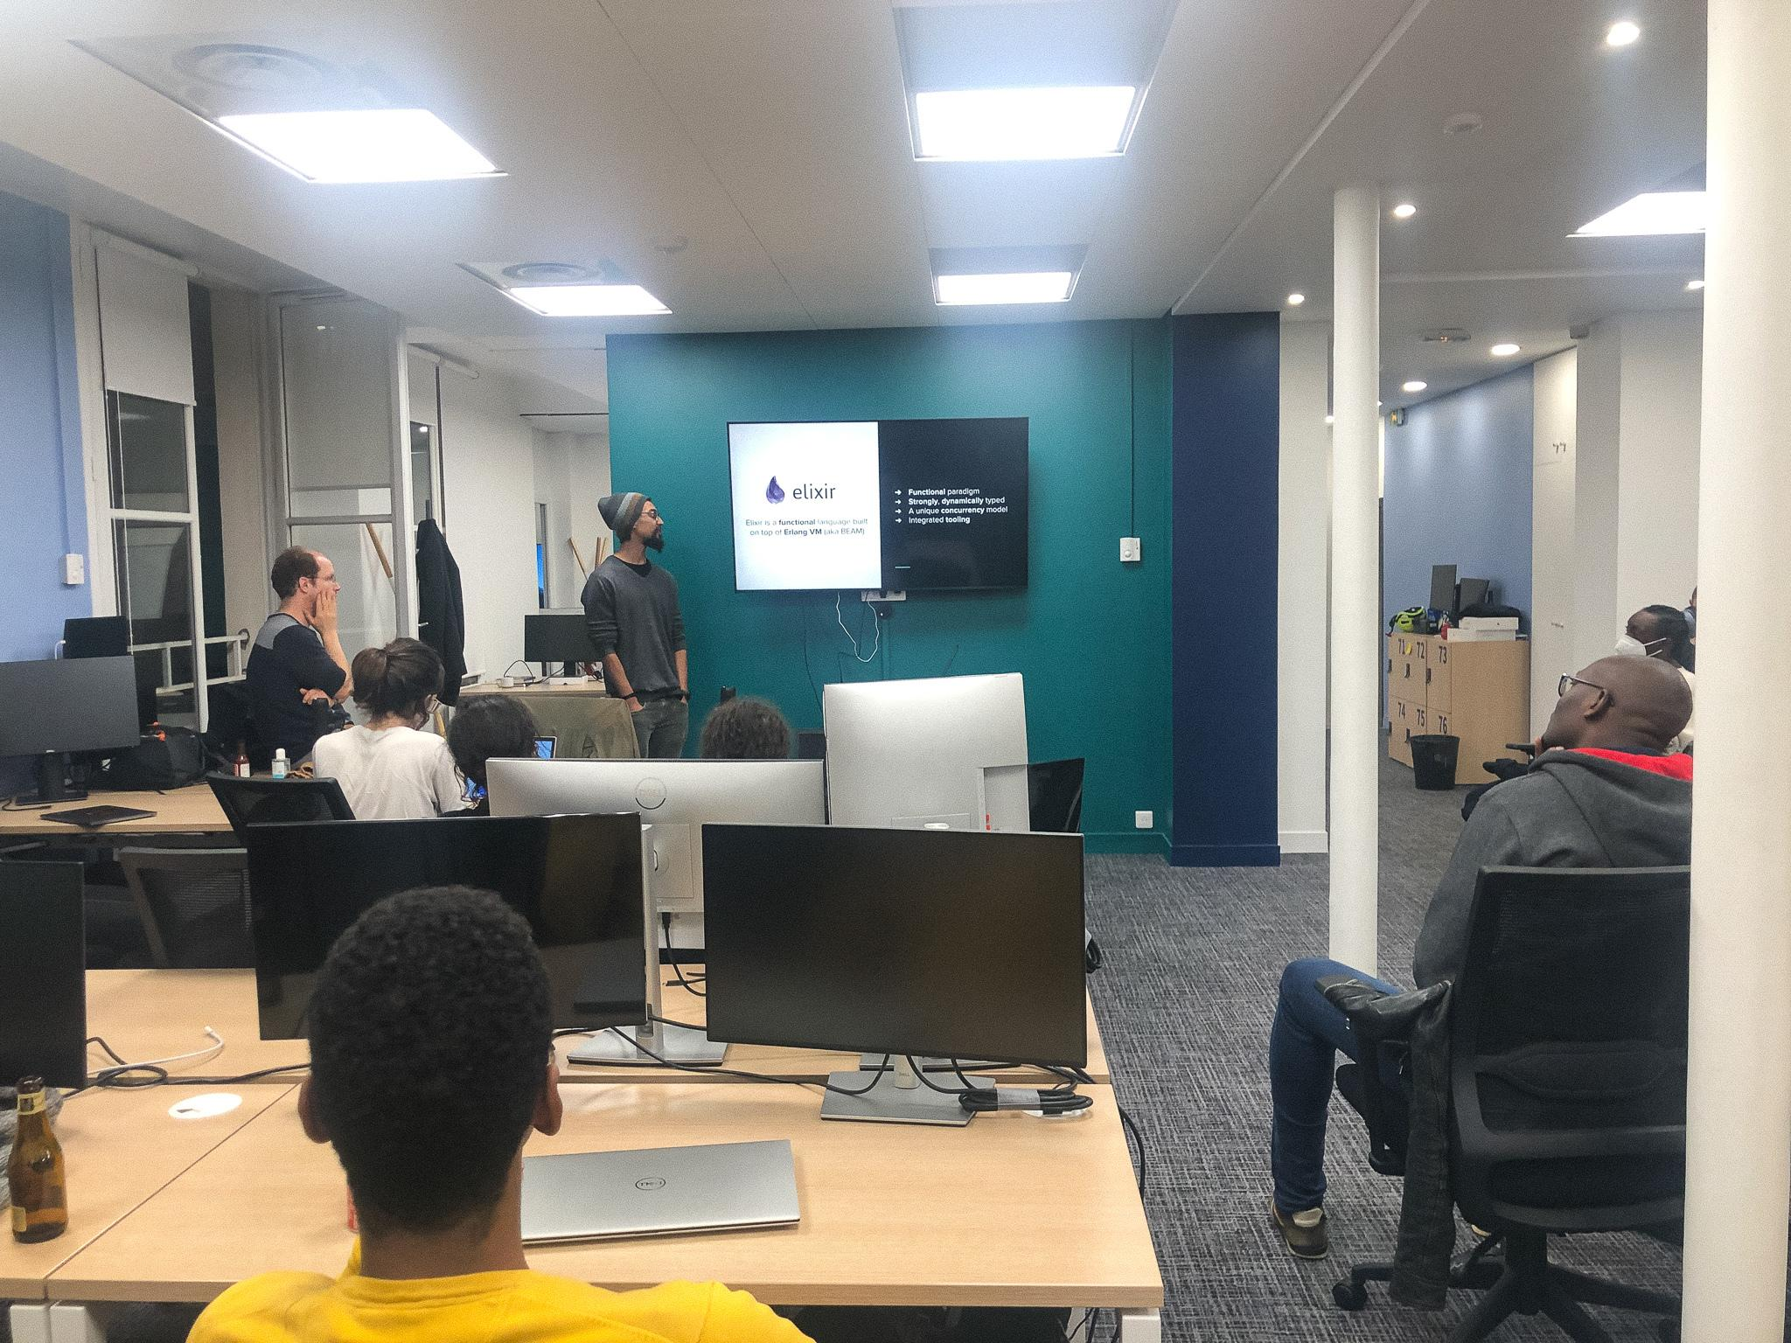
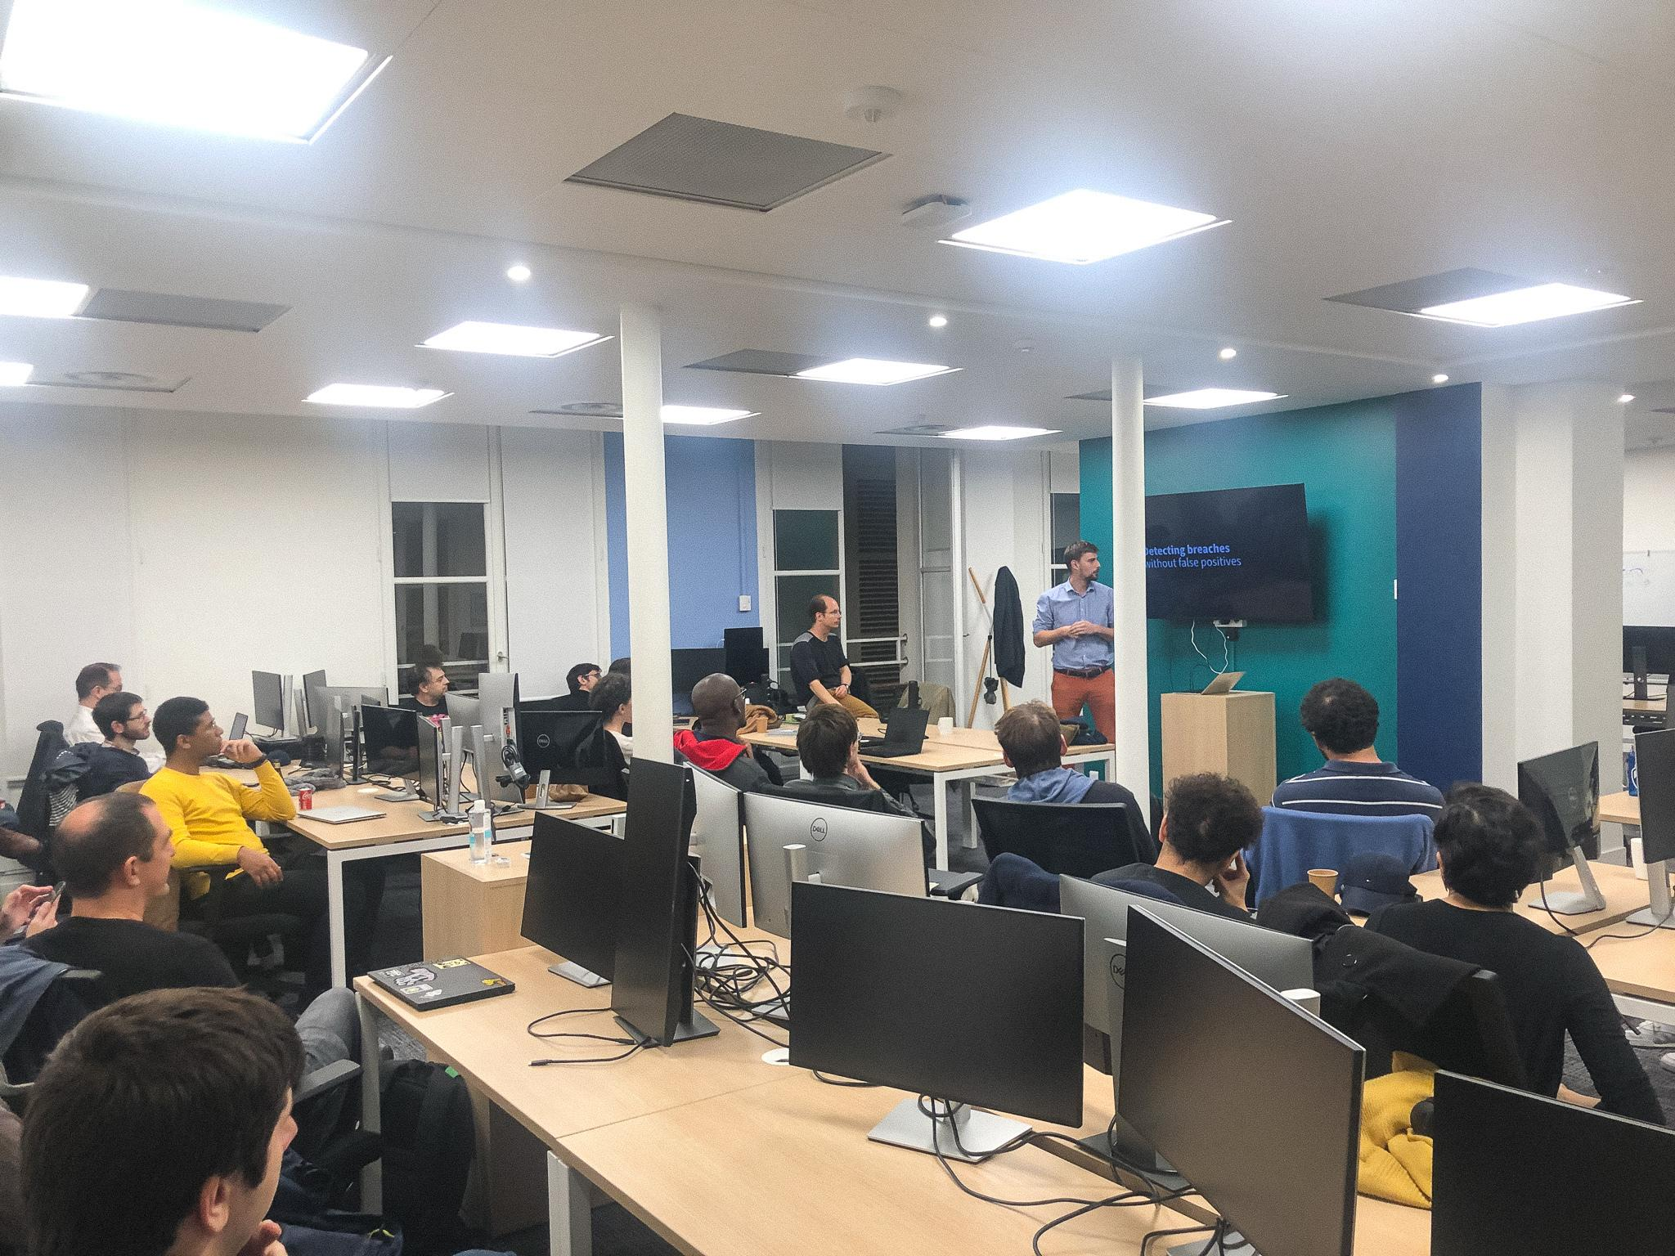
OWASP Community
OWASP Meetup at the GitGuardian Office October 2022

Slide 40
Events

Slide 41
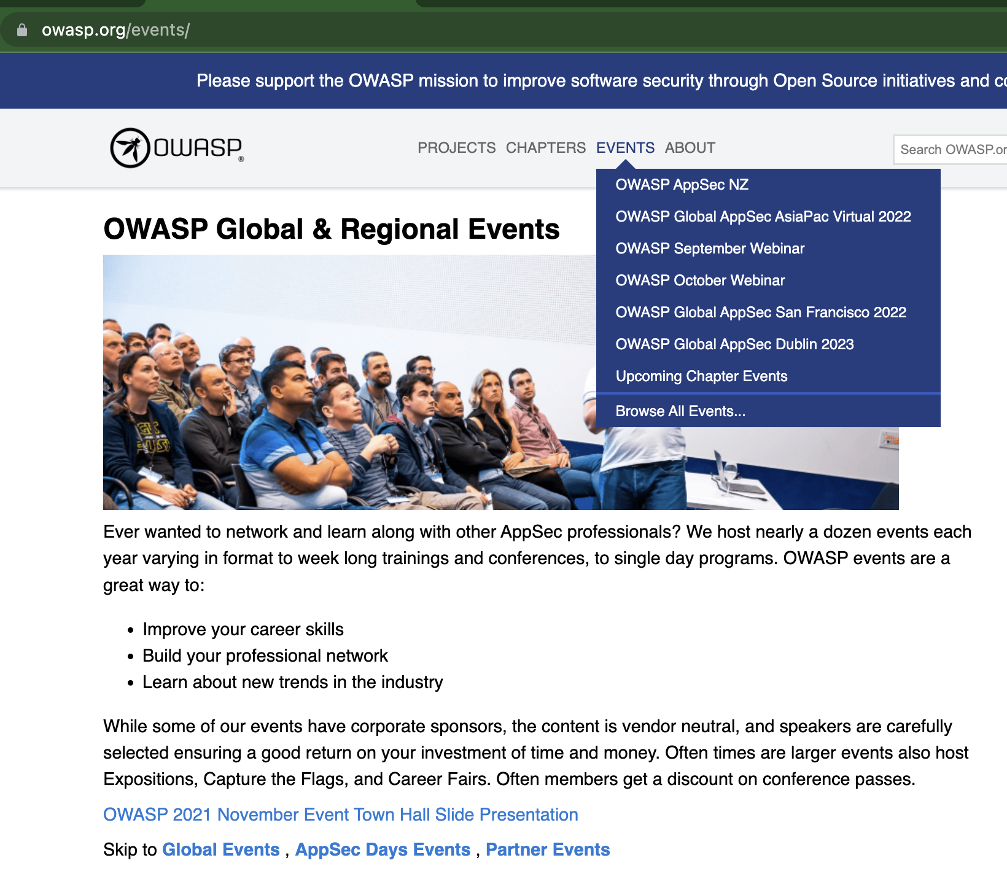
OWASP Events
Multiple events per year Global Events AppSec Days Partner Events

Slide 42

OWASP Events

Slide 43
Education and Training

Slide 44

OWASP Education And Training
https://secureflag.owasp.org/

Slide 45
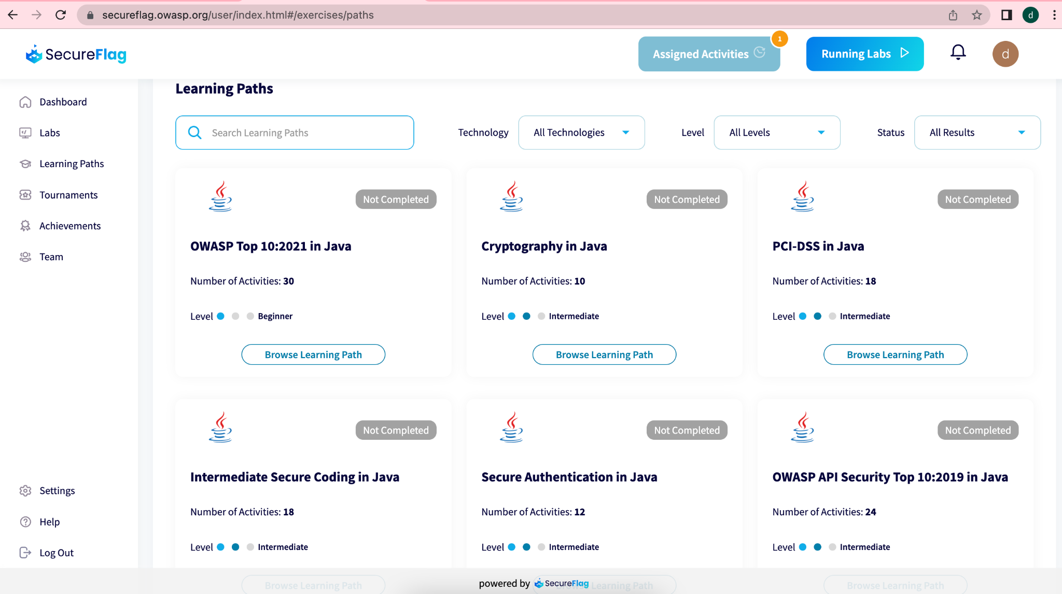
OWASP Education And Training
https://secureflag.owasp.org/

Slide 46
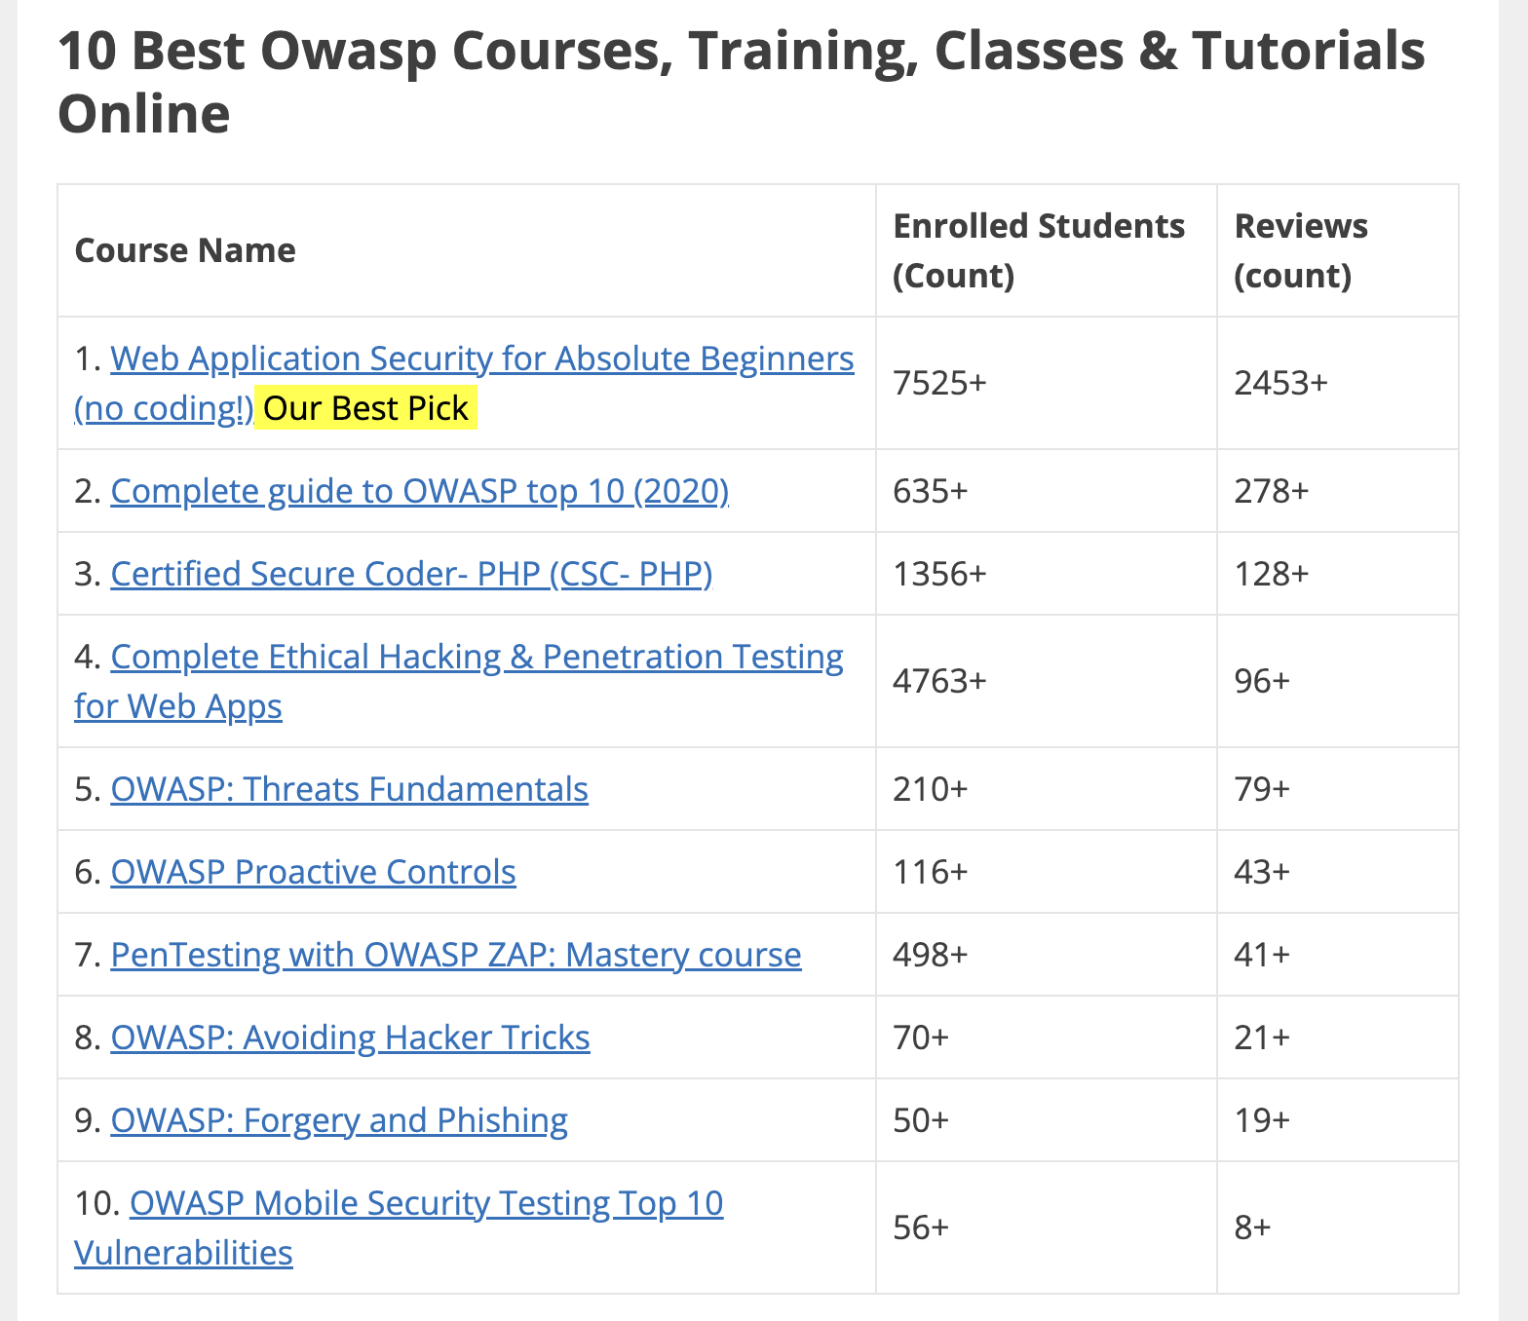
OWASP Education And Training
Notes:
https://www.douglashollis.com/best-owasp-course-training-class-tutorial-certification-online/

Slide 47
Publications and Resources

Slide 48
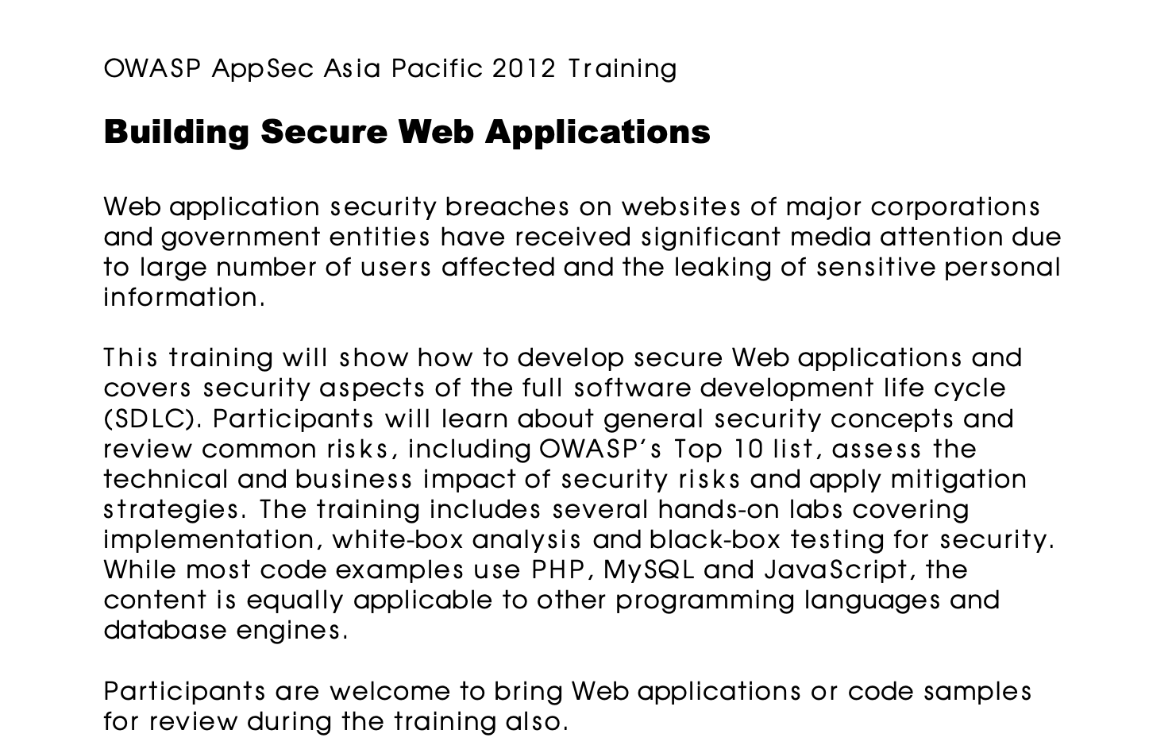

OWASP Publications and Resources
Books
Many free resources online There is a good deal of crossover with Projects
Notes:
https://www.amazon.com/OWASP-Complete-Guide-Service-Publishing/dp/1867423413

Slide 49
OK, OWASP Does A Lot
How can I use this?

Slide 50
OWASP Getting Started
Top 10
Cheat Sheet Series
Goats
ZAP
Notes:
https://www.amazon.com/OWASP-Complete-Guide-Service-Publishing/dp/1867423413

Slide 51
Top 10 Types Of Attacks

Slide 52

OWASP Top 10 Types of Attacks
“The OWASP Top 10 is a standard awareness document for developers and web application security. It represents a broad consensus about the most critical security risks to web applications.” Updated Yearly
Notes:
https://www.amazon.com/OWASP-Complete-Guide-Service-Publishing/dp/1867423413

Slide 53
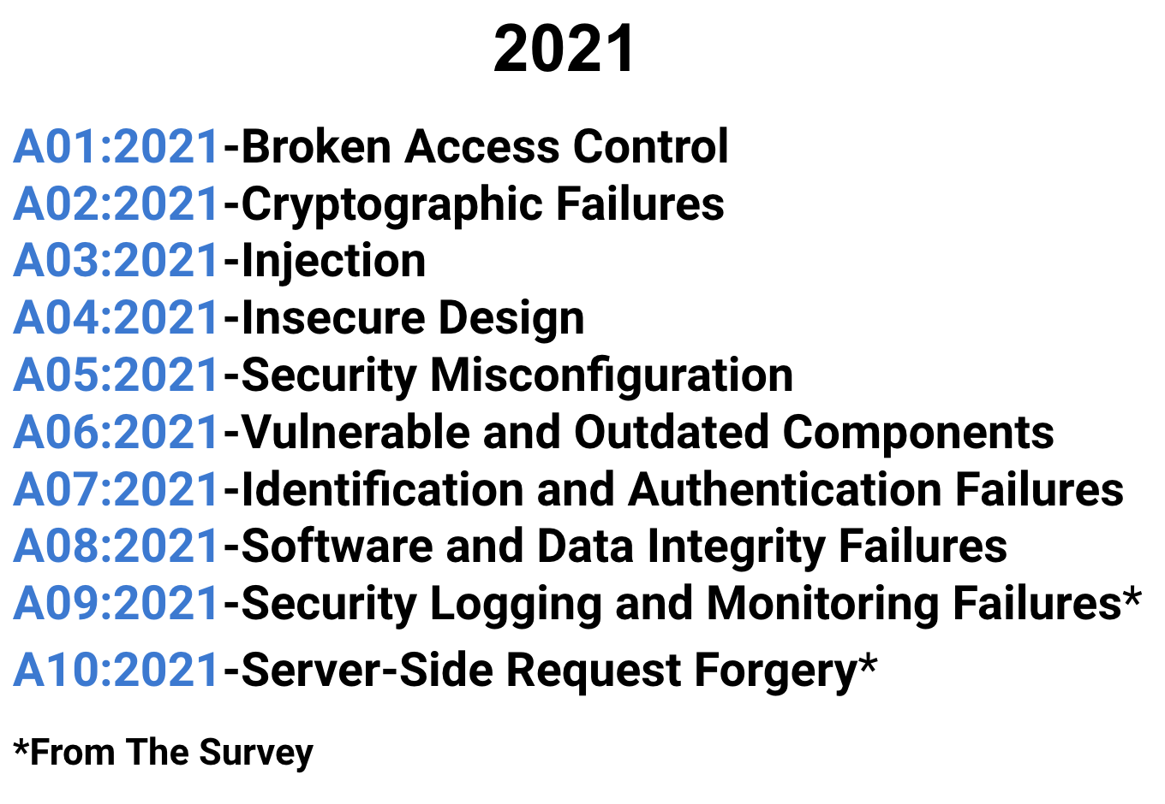
OWASP Top 10 Types of Attacks

Slide 54
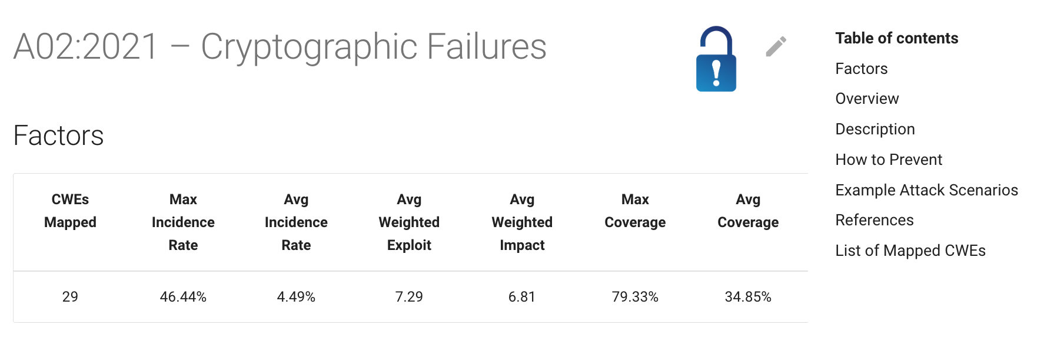
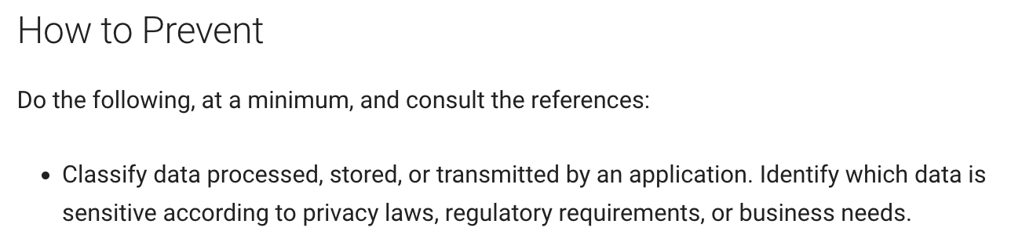
OWASP Top 10 Types of Attacks
Notes:
https://www.amazon.com/OWASP-Complete-Guide-Service-Publishing/dp/1867423413

Slide 55
Cheat Sheet Series

Slide 56
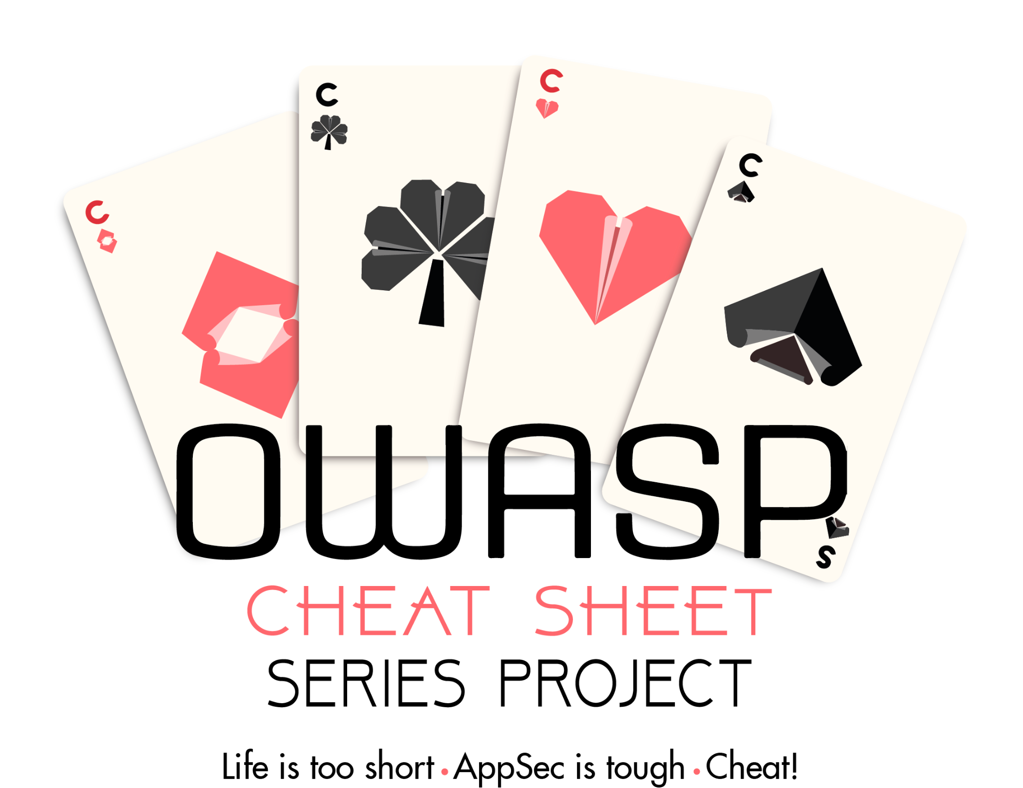
OWASP Cheat Sheet Series
https://cheatsheetseries.owasp.org/
Notes:
https://www.amazon.com/OWASP-Complete-Guide-Service-Publishing/dp/1867423413

Slide 57
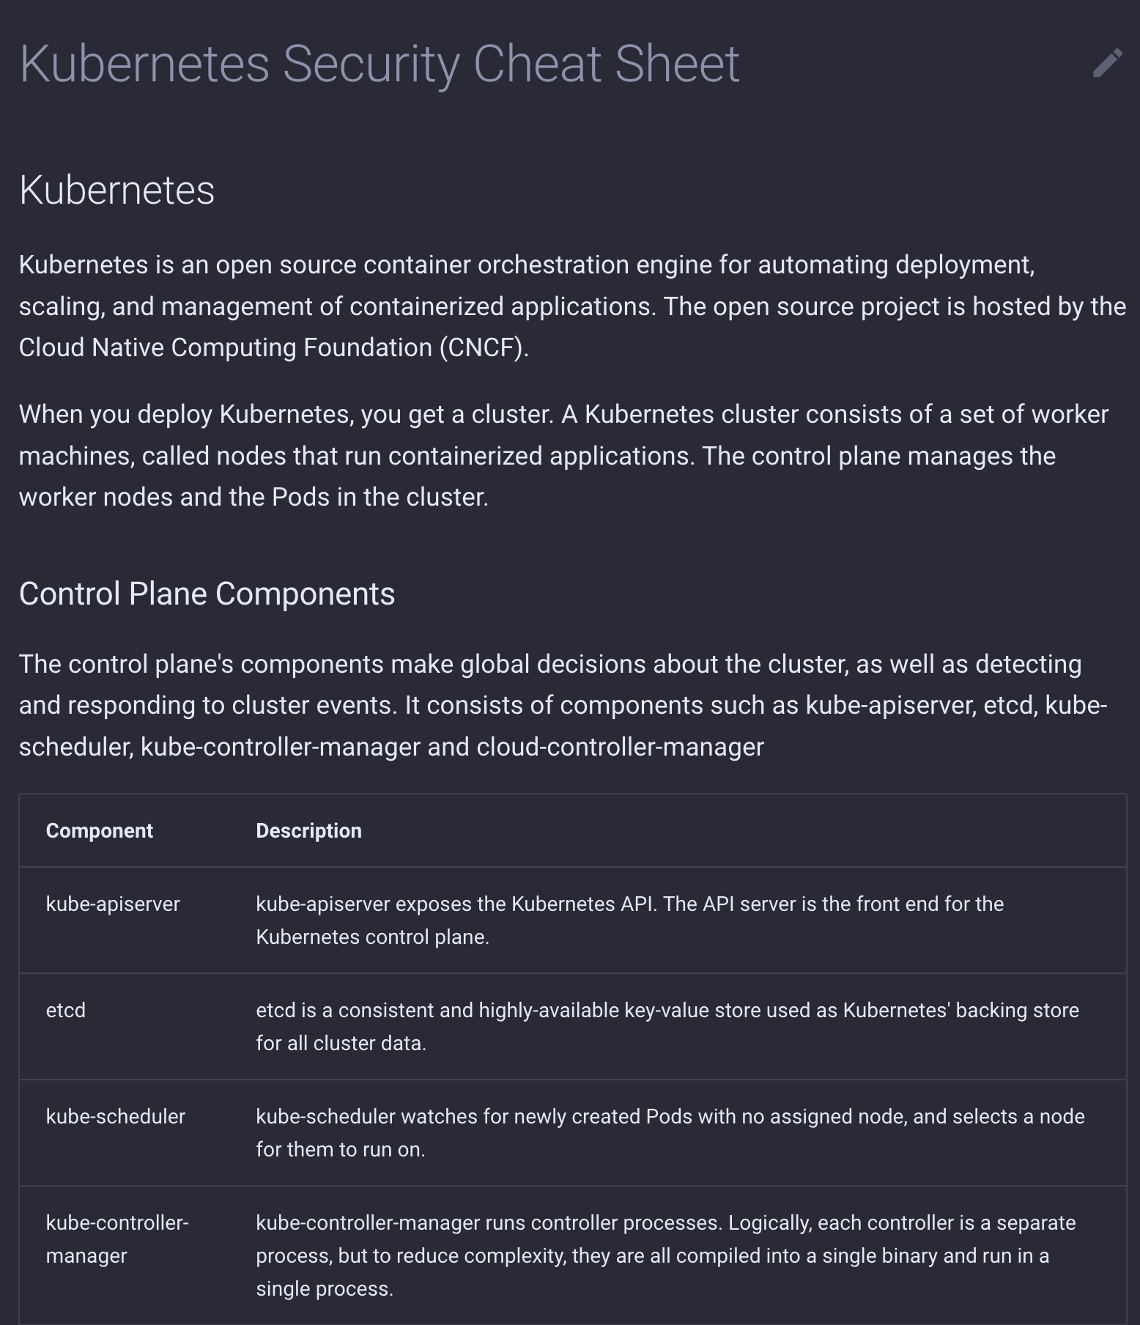
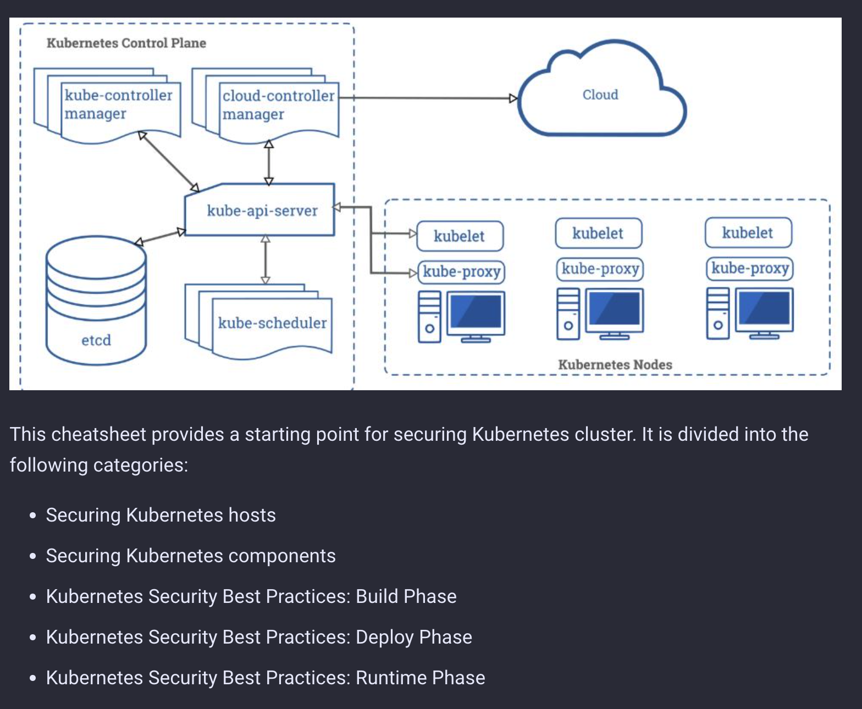
OWASP Cheat Sheet Series
Notes:
https://www.amazon.com/OWASP-Complete-Guide-Service-Publishing/dp/1867423413

Slide 58
Goats ‘Greatest Of All Time???’

Slide 59
OWASP Goats
Goats are deliberately insecure applications for testing and training purposes
Lab Projects
WebGoat
Node.js Goat
WrongSecrets
Incubator Projects or Proposed
Pygoat
AndroGoat
ChainGoat
Laravel Goat
Webgoat PHP
SupplyChainGoat
Notes:
https://www.amazon.com/OWASP-Complete-Guide-Service-Publishing/dp/1867423413

Slide 60
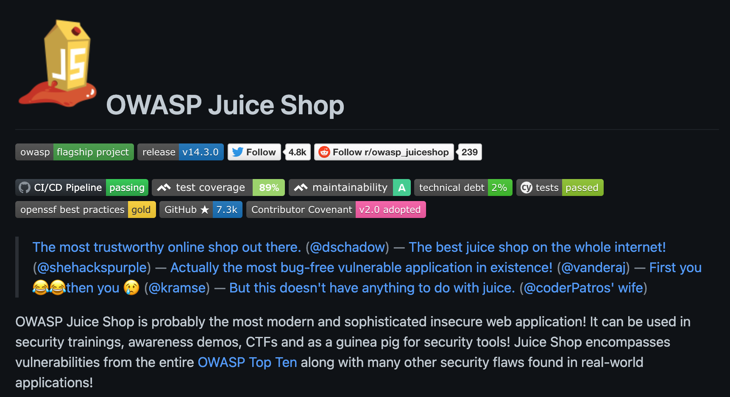
OWASP Goats
Notes:
https://www.amazon.com/OWASP-Complete-Guide-Service-Publishing/dp/1867423413

Slide 61
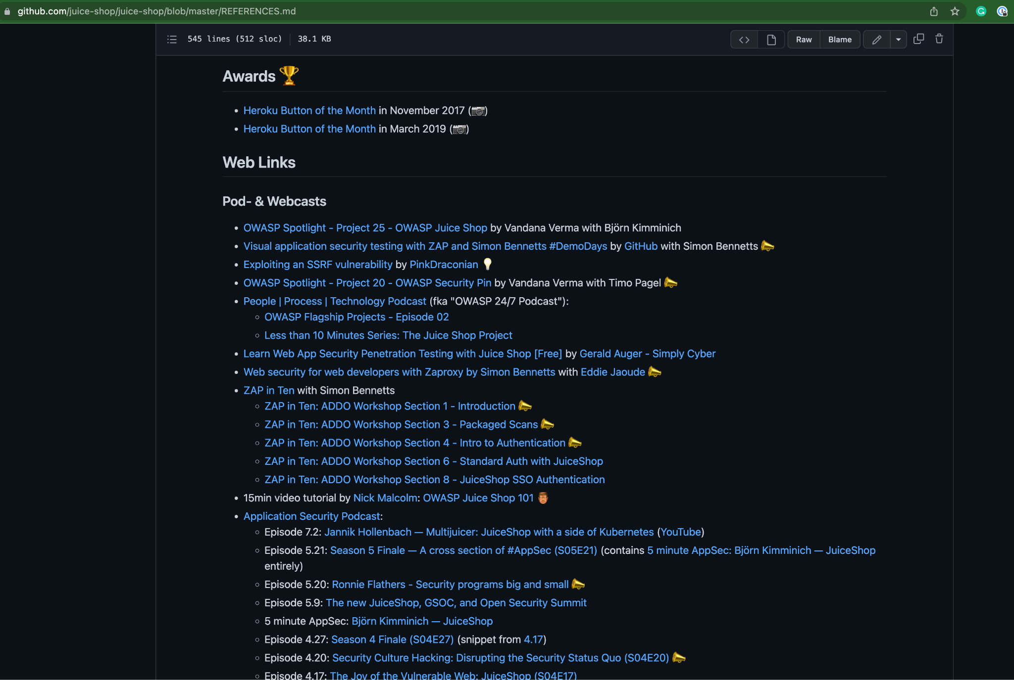
OWASP Goats
Extremely well
documented
an discussed
in media
Notes:
https://github.com/juice-shop/juice-shop/blob/master/REFERENCES.md

Slide 62
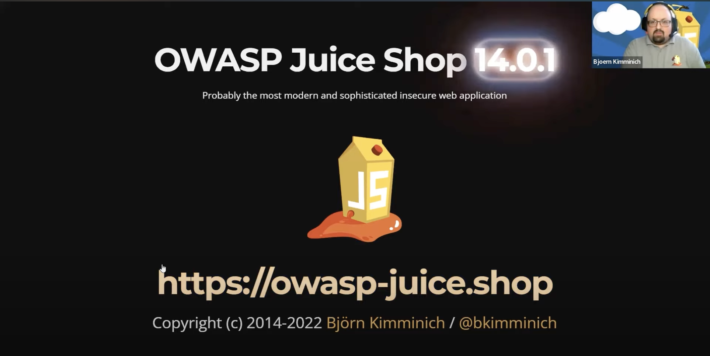
Demo by maintainer on YouTube
https://www.youtube.com/watch?v=n9DK87g_AIo
Notes:
https://github.com/juice-shop/juice-shop/blob/master/REFERENCES.md

Slide 63
ZAP

Slide 64
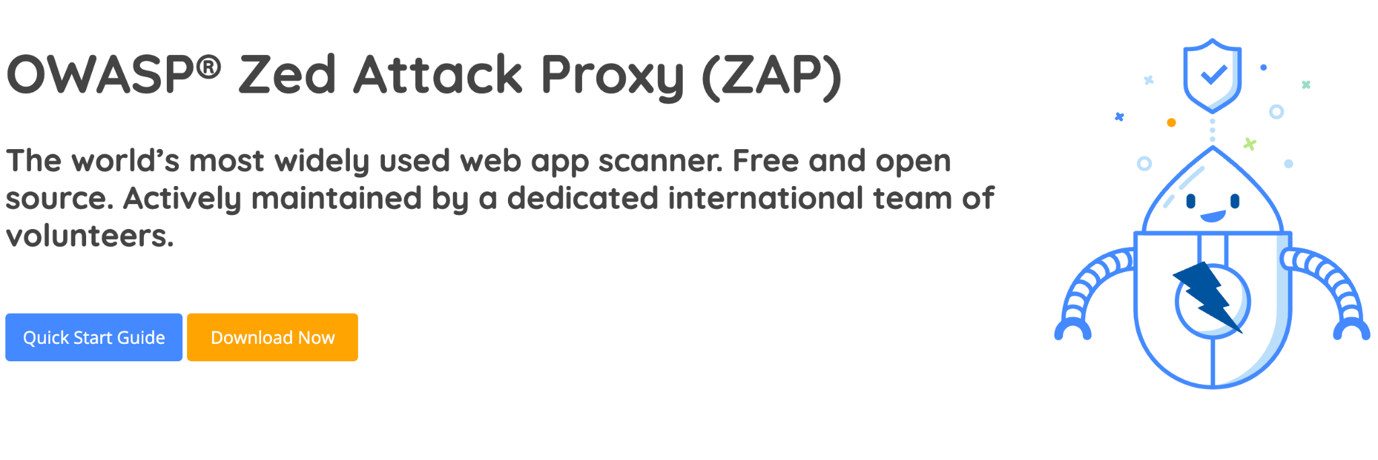
OWASP ZAP
Notes:
https://www.amazon.com/OWASP-Complete-Guide-Service-Publishing/dp/1867423413

Slide 65
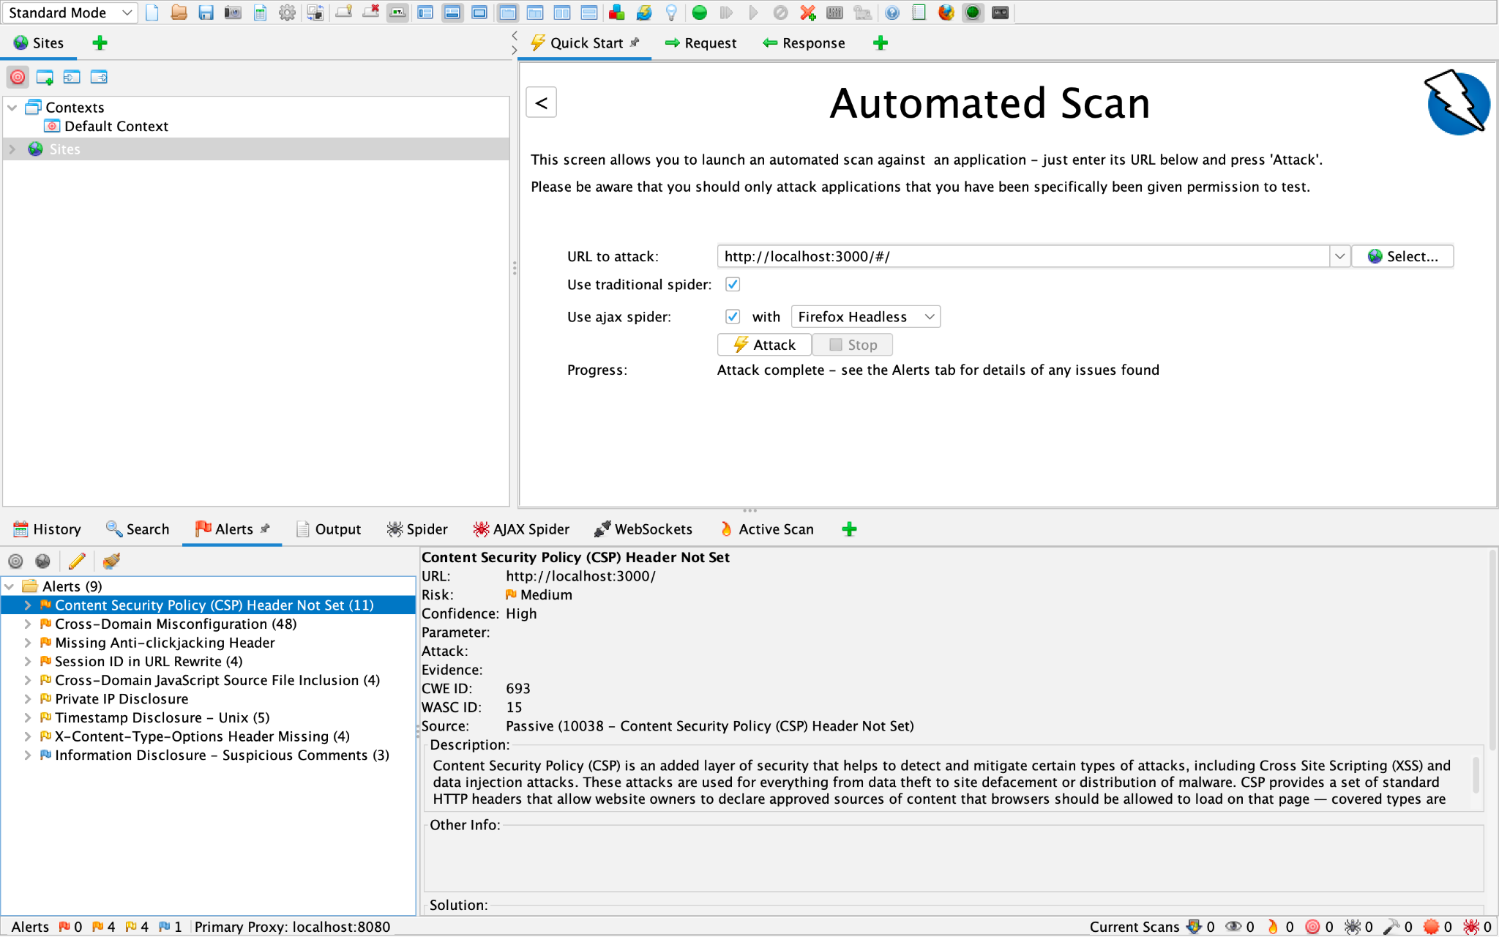
OWASP ZAP
Notes:
https://www.amazon.com/OWASP-Complete-Guide-Service-Publishing/dp/1867423413

Slide 66
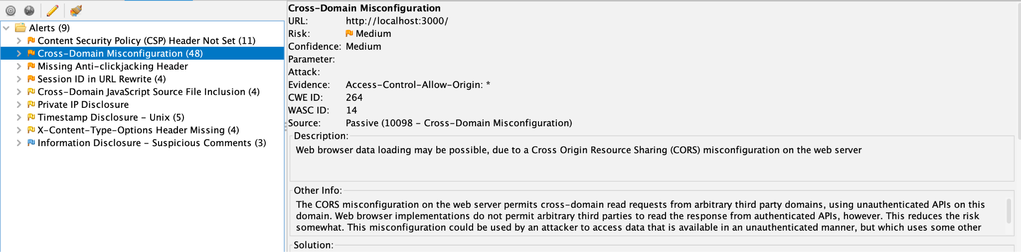
OWASP ZAP
Notes:
https://www.amazon.com/OWASP-Complete-Guide-Service-Publishing/dp/1867423413

Slide 67
In Conclusion

Slide 68
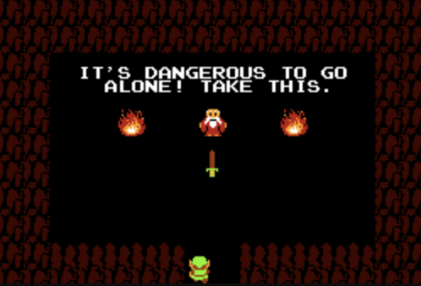

Notes:
https://www.amazon.com/OWASP-Complete-Guide-Service-Publishing/dp/1867423413

Slide 69
Notes:
https://unsplash.com/photos/MtBsjmC4RT0

Slide 70
OWASP Getting Started
Top 10
Cheat Sheet Series
Goats (not the ‘greatest of all time’)
ZAP
Notes:
https://www.amazon.com/OWASP-Complete-Guide-Service-Publishing/dp/1867423413

Slide 71
Hi, I’m Dwayne
I live in Chicago
I’ve been a Developer Advocate since 2016
On Twitter @mcdwayne
Happy to chat about anything, hit me up
Besides tech, I love improv, karaoke and going to rock and roll shows!
Dwayne McDaniel

Slide 72

Security Does Not Need To Be Fun: Ignoring OWASP To Have A Terrible Time

